Slide 1
SLIDE 1 PROBLEM & WHY IT MATTERS
Seniors are growing faster than the clinics that serve them
Team name
[Team name]
Problem statement
A3 HealthPulse: community healthcare demand forecasting
The problem in one sentence
Some towns are running out of clinic capacity faster than others, and nobody can see which ones first, or whether the new polyclinics will open in time.
Who is affected, and how badly
Singapore's 65+ population grew 45% between 2015 and 2022, to 735,000. Polyclinics and GP clinics grew 28% over the same years.
Why it matters now
Healthier SG has signed up 1.4 million residents (May 2026), so more care lands on GPs. MOH is choosing polyclinic sites right now, and Bishan's has already slipped past 2030.
Seniors per clinic in Singapore
293
in 2022, up from
259 in 2015
Seniors (65+)
+45%
Clinics
+28%
Change from 2015 to 2022, from the DAISI data pack (population by age; MOH primary care facilities).
And the pipeline is already slipping
2025 plan
Bishan polyclinic by 2030
→
2026 update
Pushed beyond 2030
DAISI Challenge Singapore 2026 · Round 1 template · keep to 3 slides, export as PDF

Slide 2
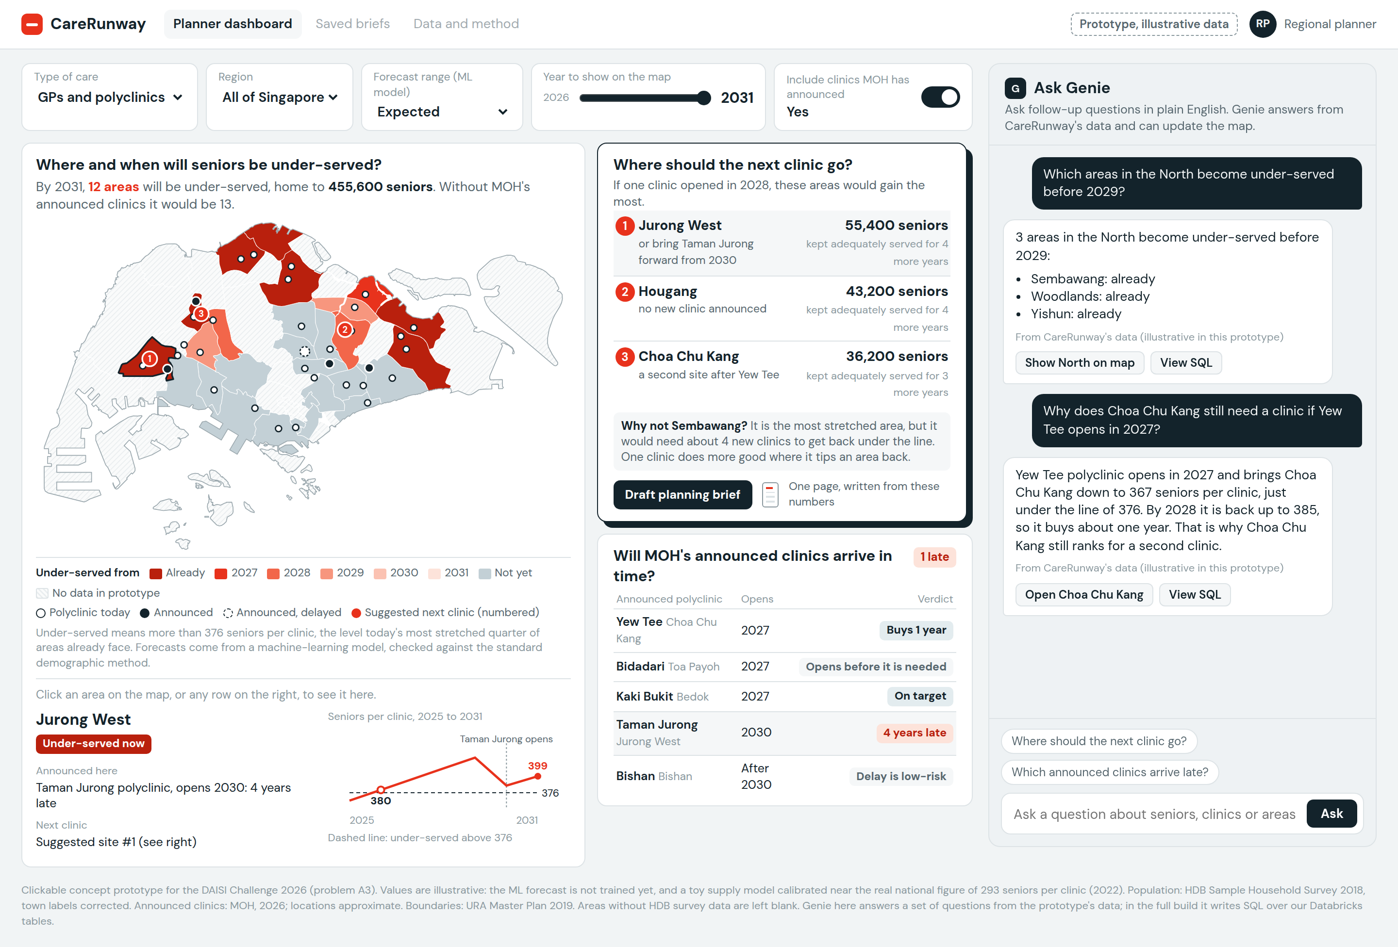
SLIDE 2 SOLUTION & DATA
CareRunway tells planners where the next clinic should go
Your solution in one sentence
A planning tool that uses machine learning to forecast seniors per clinic in every area to 2031, checks MOH's announced polyclinics, and ranks where one new clinic helps most.
Who uses it, and what decision it changes
Planners at the three regional health clusters, deciding where the next Healthier SG clinic goes.
Datasets we will use
1. Residents by area, age and sex, 2000 to 2025 (SingStat)
2. Clinic and polyclinic locations (data.gov.sg, MOH)
3. Hospital admissions 1987 to 2026 (DAISI pack); admission rates by age (MOH)
While cleaning the data, we found 8 towns mislabelled in a government dataset. It overturned one of our own early findings.
Different from a generic dashboard
Most dashboards show where seniors live today. Ours says where the next clinic should go, checks MOH's own plans, and tests its forecast against the standard demographic method.
Try the prototype: claude.ai/artifact/KWxnv7oRJRx4aS9JTt8oXy
Concept only: illustrative data, and many features are not built yet.
DAISI Challenge Singapore 2026 · Round 1 template · keep to 3 slides, export as PDF

Slide 3
SLIDE 3 DATABRICKS ARCHITECTURE & IMPACT
Our data is already in Databricks. Here is how it becomes a recommendation.
Sources
SingStat, data.gov.sg, MOH, DAISI pack, URA boundaries
Ingestion
Lakeflow Jobs land raw files in a Unity Catalog Volume
Transform
Delta bronze, silver, gold: label fixes, geocoding, catchments
Models
MLflow: ML area forecast, tested against the standard method; admissions forecast
Outputs
Site optimiser, AI/BI map dashboard, Genie space, App for briefs
→
→
→
→
We use the ML forecast only where it wins: train to 2015, predict 2020; train to 2020, predict 2025, and compare its error with the standard method.
What we'll demo
A planner flips planned clinics on and off, clicks an area, asks Genie a question, and leaves with the top three sites and a one-page brief.
How we'll measure impact
Seniors living in under-served areas by 2031, with and without our recommended sites, and forecast error versus the standard method.
What we can finish in two weeks
Week 1: pipeline, standard forecast, ML forecast and backtest. Week 2: site optimiser, planned-clinics check, dashboard, Genie. Stretch: nursing homes.
Paste a Databricks screenshot here
Seniors per clinic, 2009 to 2022, queried from workspace.carerunway
Team: [Name] (data and models), [Name] (supply and mapping), [Name] (product and pitch)
DAISI Challenge Singapore 2026 · Round 1 template · keep to 3 slides, export as PDF
Notes:
If the Databricks screenshot isn't ready, change the title to: 'Built end to end on Databricks, with its error on screen' and delete the screenshot frame.

